Slide 1
Obesity Prediction Using Machine Learning Methods
By: Tris Marie Joe (18BCE2299)
Nidhi Mankala (18BCE2387)
Guide: NAVEEN KUMAR N

Slide 2
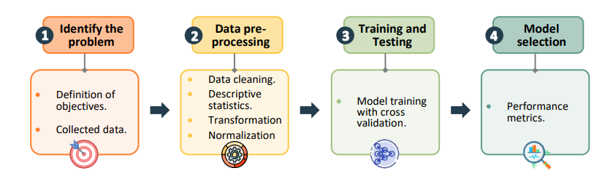
Our objective
To determine the Machine Learning model to create a highly accurate obesity prediction model.
Dataset used: Consists of 2111 instances of data with 17 properties. We used this dataset as it is a dataet that considers lot of varying features such as dietary habits, physical conditions and more.
Machine Learning methods: We researched various types of ML methods and them implemented a total of 11 ML methods on the dataset.
Performance Metrics: We used 4 different performance metrics to compare the results of the ML methods.

Slide 3
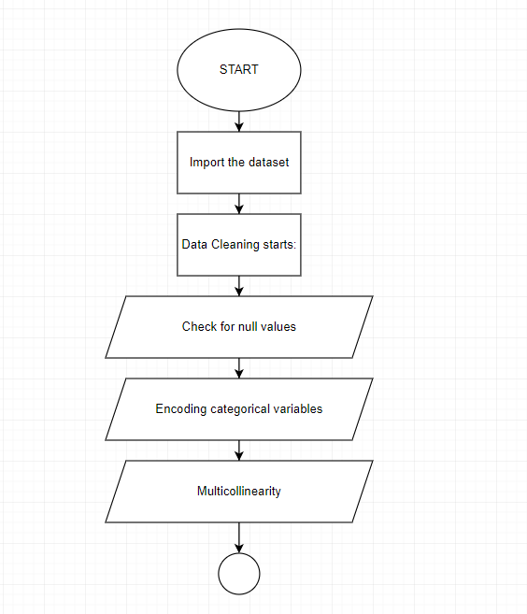
FLOWCHART

Slide 4
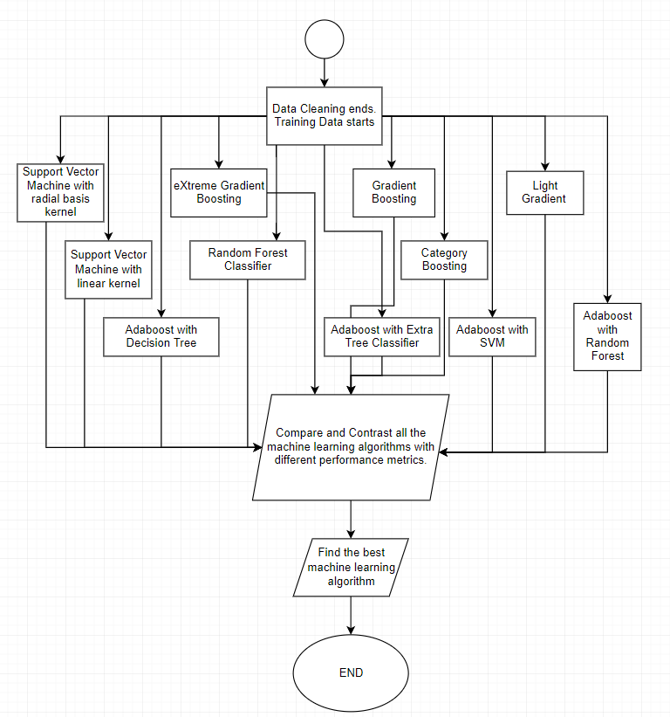

Slide 5
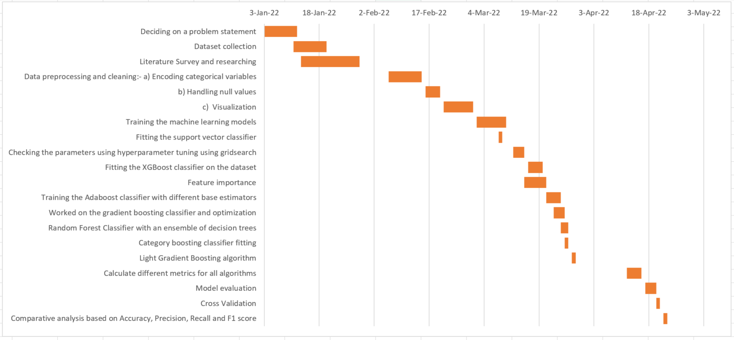
roadmap

Slide 6
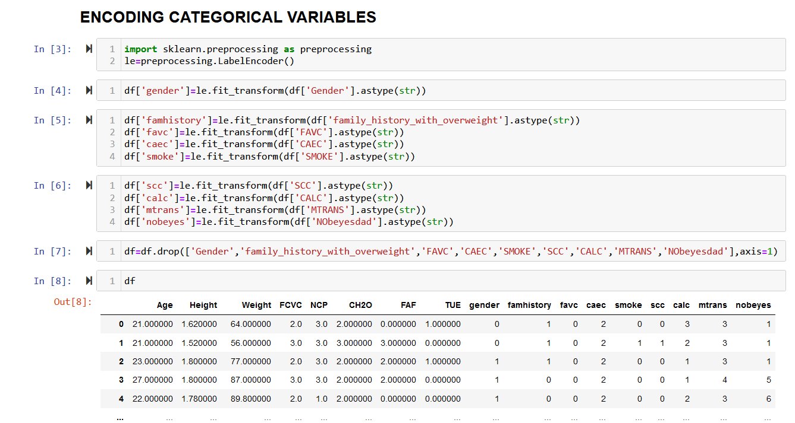
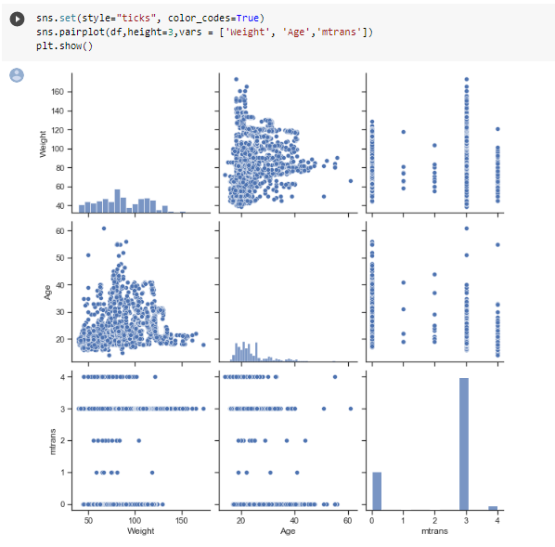
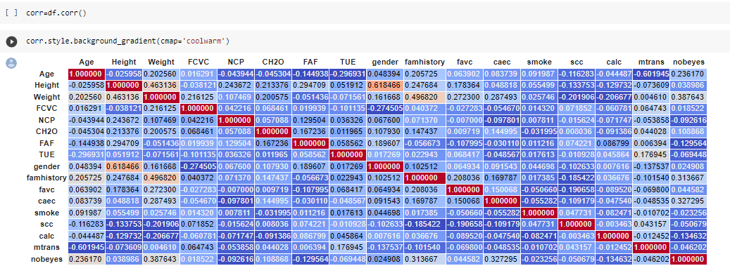
Result

Slide 7
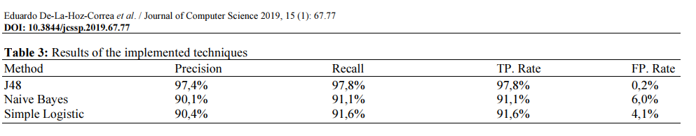
Results from base paper
Reference: https://thescipub.com/pdf/jcssp.2019.67.77.pdf
(Obesity Level Estimation Software based on Decision Trees )

Slide 8
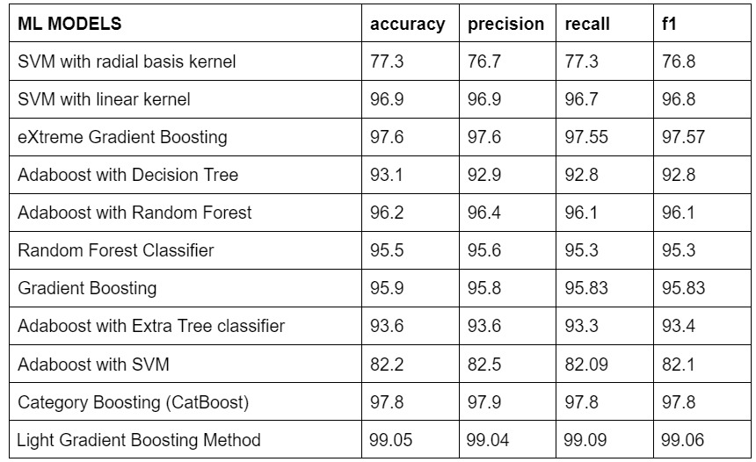
Result
From our comparative analysis we see that the Light Gradient Boosting Method which gives an accuracy of 99.09% is the best ML algorithm for this prediction based model.

Slide 9
Future work
Obesity has now evolved into a global condition that affects people of all ages and genders all over the world. This project can now be used a the base for an obesity prediction model which can give a highly accurate prediction to the user. The ML model can also be checked its efficiency with an even larger dataset with more attributes in the future. This model can also be implemented as a part of a symptom checker project to give accurate predictions for this kind of health related issue which is socially beneficial to the society.

